Slide 1
Intro to Programming
2022 Erik Kesa

Slide 2
What Will you be learning this semester?
Programming as the art of communication between person and machine.
Programming as a team-based effort of building something great.
The programmer’s mindset to solving a problem.
Programming from the machine’s perspective.
The basics of C - the mother of all most programming languages.
Fundamental concepts of computer science, software development and game programming.

Slide 3
How will the course be structured?
Each 4 lesson meeting will be divided into a theoretical part (2 lessons) and a practical part (2 lessons) to provide time for presentation of homeworks and solve HackerRank challenges.

Slide 4
Meetings And Topics
- 07. Feb 2022 14:00 [4h] – Course overview, Intro to C, compilation and Hello World
- 14. Feb 2022 14:00 [4h] –- Variables and statements ,
- 21. Feb 2022 14:00 [4h] – Data Types
- 28. Feb 2022 10:00 [4h] – Loops and Functions
- 07. Mar 2022 10:00 [4h] – Pointers and Arrays
- 14. Mar 2022 10:00 [4h] – First homework Deadline

Slide 5
Meetings And Topics
- 21. Mar 2022 10:00 [4h] – Structures and Strings
- 28. Mar 2022 10:00 [4h] – Working with strings
- 04. Apr 2022 10:00 [4h] - Data structures [Linked List], File I/O
- 11. Apr 2022 10:00 [4h] – Second Homework Deadline, Linked list [P]
- 25. Apr 2022 10:00 [4h] –- Overview of Object Oriented programming
- 02. May 2022 10:00 [4h] – Overview of C++
- 09. May 2022 10:00 [4h] – Final project presentation [P]

Slide 6
Grading
HackerRank - Total challenges 11 easy and 9 medium – Each easy gives one point, and medium 2 points. (As a minimum, 10 challenges must be solved). Hackerrank challenges will be solved during practice lessons, at an individual pace, with consultation available.
Homeworks - 2 homeworks total, each giving 15 points.
Final project – will count for 50 points.

Slide 7
Results
91-100p = “5”
81 -90 = ‘4”
71-80 = “3”
61-70 = ”2”
51 – 60 = “1”

Slide 8
First homework - 14. Mar 2022
The aim of this homework will be to create a basic calculator. The criteria will be: a) The calculator enables addition, subtraction, multiplication and division b) The calculator has an understandable user interface c) The calculator handles invalid input by the user by returning an error message where appropriate d) The results produced are correct. e) The calculator does not crash

Slide 9
Second Homework - 11. Apr 2022
The aim of this homework will be to create a game database application. a) The game database will be an application to store info about games that a person owns b) It should support adding new games and removing existing ones. c) It should be queryable by an identifier, Game title and Publisher d) All information should be stored in a file.

Slide 10
Final Assignment
The Aim of the assignment will be to create a text-based RPG game using C. The result should be a terminal based application Game Requirements:
Combat mechanic - The game should have a player character who will battle monsters and explore dungeons. The combat mechanic should contain some randomness.
Player - The player should have at least 3 statistics: Life, Attack Strength, Defense Strength
Monsters – The monsters should have at least 3 statistics: Life, Attack Strength, Defense Strength
Implemented player choice – The story should present at least 3 player choice moments.
User Interface – Command line.
File persistence
Story
The Game has to work!

Slide 11
Rules
Any and All code you write – you must be able to explain!
I dislike the sound of my voice being combined with that of yours, so let’s take turns speaking.
Failure to meet a deadline will result in 5 points subtracted from the final result.

Slide 12
Useful resources
Https://www.hackerrank.com - practice environment, will be used in practice lessons
https://www.tutorialspoint.com/cprogramming/ - covers basic topics, that we will be going over during lessons.
https://www.gnu.org/software/gnu-c-manual/gnu-c-manual.html – the C language reference.
https://www.tutorialspoint.com/compile_c_online.php - online C compiler

Slide 13
Questions?

Slide 14
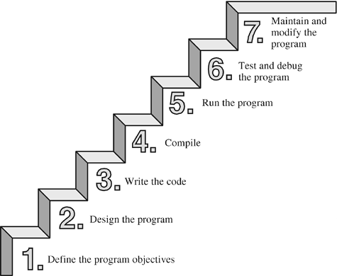
Software Development Basics
The aim of software development is to create computer programs for the users. Software developers achieve this through programming – creating the source code containing instructions for a computer to act in certain ways or manipulate data in order to achieve some result.

Slide 15
Software Development Basics
An algorithm is a set of instructions for solving a problem or accomplishing a task.
An example of an algorithm is a recipe.

